Slide 1
PCR, INC. POST COVID-19 OPERATIONAL GUIDE

Slide 2
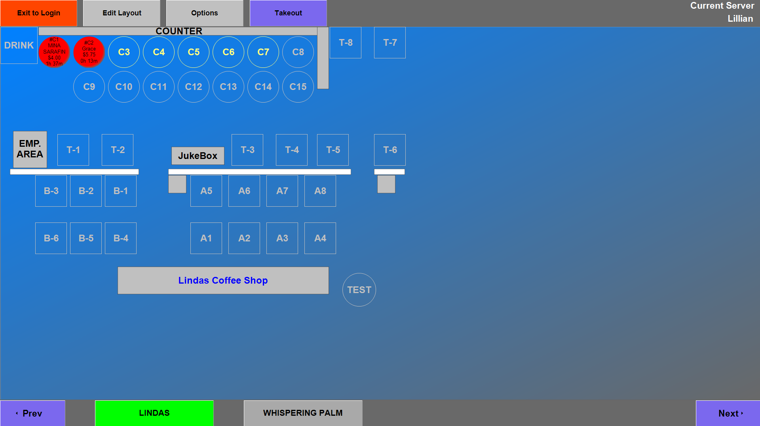
TAKE OUT
4pax
EMPLOYEE/VENDOR
ENTRANCE/EXIT
EXIT
4pax
4pax
4pax
4pax
4pax
4pax
4pax
4pax
4pax
6pax
6pax
6pax
Entrance

Slide 3
OPERATIONS TO BE DONE AT 50% OF OUR CAPACITY.
CERTIFIED FOOD MANAGER (PIC) ON PREMISES AT ALL TIMES.
ALL STAFF AND CUSTOMERS TO ADHERE TO SOCIAL DISTANCING GUIDELINES AS SET FORTH BY DPHSS.
DOOR HANDLES, LIGHT SWITHCES AND RESTROOM FIXTURES TO BE SANITIZED OFTEN THROUGHOUT THE DAY.
SANITIZER ON SHIFT TO ENSURE ALL HIGH TOUCH SURFACES ARE CONSTANTLY SANITIZED.
HOST/HOSTESS IN PLACE FOR CROWD CONTROL SANITATION PROTOCALS.
TEMPERATURE TAKEN BY PIC FOR EMPLOYEES AND HOST/HOSTESS FOR CUSTOMERS.
ANY DISPLAYS OF FEVER, COUGH, OR ANY FLU-LIKE SYMPTOMS TO BE DENIED DINE-IN FOR CUSTOMERS AND CLOCKING IN FOR EMPLOYEES.
ALL SERVERS, COOKS, SANITIZERS TO WEAR GLOVES AND CHANGE AFTER EACH TASK.
ALL PERSONS IN BUILDING TO BE WEARING MASKS.
ALL KITCHEN SURFACES TO BE WIPED AND SANITIZED THROUGHOUT DAY AND BETWEEN TASKS.
SERVERS TO WASH THEIR HANDS NO LESS THAN EVERY 20 MINUTES AND BETWEEN GLOVE CHANGES.
ANY EMPLOYEE WHO FALLS ILL OR HAS BEEN IN CONTACT WITH ANYONE WHO IS ILL MAY NOT COME TO WORK AND MUST GET CLEARANCE FROM A DOCTOR IN WRITING TO RETURN TO DUTY.
ALL EMPLOYEES TO UTILIZE RESTROOMS LOCATED IN THE WHISPERING PALMS.
Our Commitment to our staff and customers

Slide 4
HOST/HOSTESS STATIONED AT CUSTOMER ENTRANCE TO MEET, GREET, SEAT, AND GUIDE CUSTOMERS. - CUSTOMER GUIDANCE TO INCLUDE BUT NOT LIMITED TO… - FACE MASK IN PLACE FOR ALL PARTIES ENTERING - TEMPERATURE TAKEN (ANYTHING ABOVE 100.0 WILL NOT BE ALLOWED TO DINE-IN) - NAMES FOR SEATING SO AS TO KEEP LOG IN EVENT CONTACT TRACING SHOULD EVER NEED TO BE DONE AND FOR CALLING UPON CUSTOMER TO BE SEATED - ENTRY AND EXIT LOCATIONS - SANITIZED MENU HANDED TO CUSTOMER - ANY THING TO BE PACKED WILL BE DONE AT THE TABLE BY THE CUSTOMER - CONDIMENTS NEED TO BE REQUESTED AND A SANITIZED BOTTLE/SHAKER WILL BE BROUGHT OVER - SERVERS TO TAKE PAYMENT AT TABLES TO CASHIER AND RETURN WITH CHANGE AND/OR CREDIT CARD RECIEPT FOR SIGNATURE
HOST/HOSTESS GUIDELINES

Slide 5
Sanitizer guidelines
- SANITIZERS TO CONSISTENTLY MOVE AROUND FLOOR WATCHING FOR TABLES AND RESTROOM USAGE.
CDC AND FOOD ESTABLISHMENT APPROVED SANITIZER TO BE IN BOTTLES.
EACH TABLE AND CHAIR TO BE SANITIZED AFTER EACH USE.
DOOR HANDLES FOR ENTRANCE AND EXIT LOCATIONS TO BE SANITIZED A MINIMUM 20 MINUTES.
RESTROOM DOOR HANDLES, LIGHT SWITCHES AND ANY HIGH TOUCH SURFACE TO BE SANITIZED AT A MINIMUM OF EVERY 20 MINUTES.
ALL CONDIMENTS TO BE SANITIZED AFTER EACH USE IN SANITIZING LOCATION.
MENUS TO BE SANITIZED AND RETURNED TO HOST/HOSTESS AREA AFTER EACH USE.
TO GO AREA CONSISTENTLY WIPED BETWEEN ORDER PREPARATION.

Slide 6
Server guidelines
SERVERS WILL WEAR MASKS AND GLOVES WHEN SERVING.
GLOVES WILL BE CHANGED AFTER EACH TABLE SERVED OR CLEARED.
SERVERS WILL WASH THEIR HANDS BETWEEN TASKS AND AT A MINIMUM OF EVERY 20 MINUTES.
SERVERS WILL HAVE THEIR MEALS AND BREAKS INDIVIDUALLY WITH NO CONGREGATION AND AWAY FROM THE GENERAL PUBLIC.
SERVERS WILL BRING SANITIZED CONDIMENTS TO TABLES AS REQUESTED.
IF A CUSTOMER HAS FOOD TO BE PACKED, SERVER WILL BRING BOXES, CUPS AND BAGS OVER FOR THE CUSTOMER TO PACK.
SERVERS WILL REFILL DRINKS WITHOUT PICKING UP CUSTOMERS CUPS.
SERVERS WILL NOT STAND AND SOCIALIZE WITH CUSTOMERS.
SERVERS WILL STAND AT A REASONABLE DISTANCE FROM TABLES WHEN TAKING ORDERS.

Slide 7
COOK GUIDELINES
COOKS TO WEAR GLOVES AND MASKS AT ALL TIMES.
GLOVES TO BE CHANGED BETWEEN TASKS TO ELIMINATE CROSS-CONTAMINATION.
HANDS TO BE WASHED NO LESS THAN EVERY 20 MINUTES AND BETWEEN GLOVE CHANGE.
COOKS TO DISTANCE THEMSELVES AS MUCH AS POSSIBLE FROM TEAM MEMBERS.
COOKS WILL CLEAN AND SANITIZE HIGH TOUCH SURFACES THROUGHOUT SHIFT AND BETWEEN TASKS.
COOKS WILL ADHERE TO ALL FOOD SAFETY GUIDELINES AS MANDATED BY DPHSS.

